Slide 1
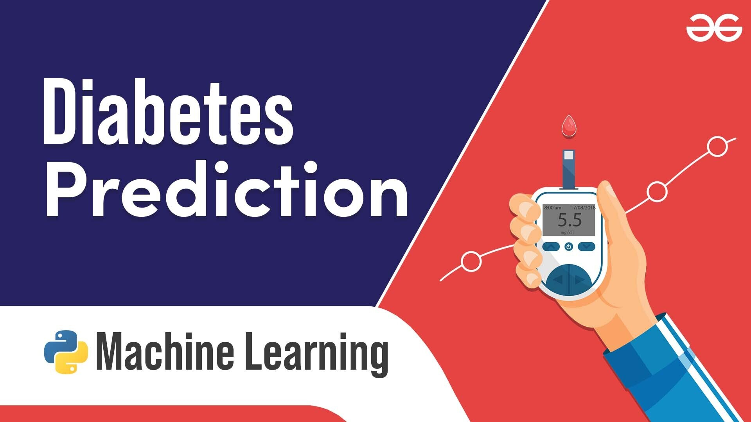
Diabetes Prediction Using Machine Learning Using Python And It’s Libraries
Analyzing and Predicting Diabetes with Various Classifiers
Presented by: Chandan Kumar

Slide 2
Introduction
To predict the likelihood of diabetes in patients using machine learning models.
To compare the performance of different classifiers in predicting diabetes.
Dataset:
Pima Indians Diabetes Dataset

Slide 3
Data Preprocessing
Load dataset and remove irrelevant features ('Pregnancies', 'SkinThickness’).
Split data into training and testing sets.
Scale features using StandardScaler.
Impute missing values in 'BloodPressure', 'Insulin', and 'BMI' with the mean.

Slide 4
Exploratory Data Analysis
Exploratory Data Analysis
Feature Distribution:
Histogram or boxplot for key features (Glucose, BloodPressure, BMI, etc.).
Target Variable:
Bar chart showing the distribution of the 'Outcome' variable (Diabetic vs. Not Diabetic).

Slide 5
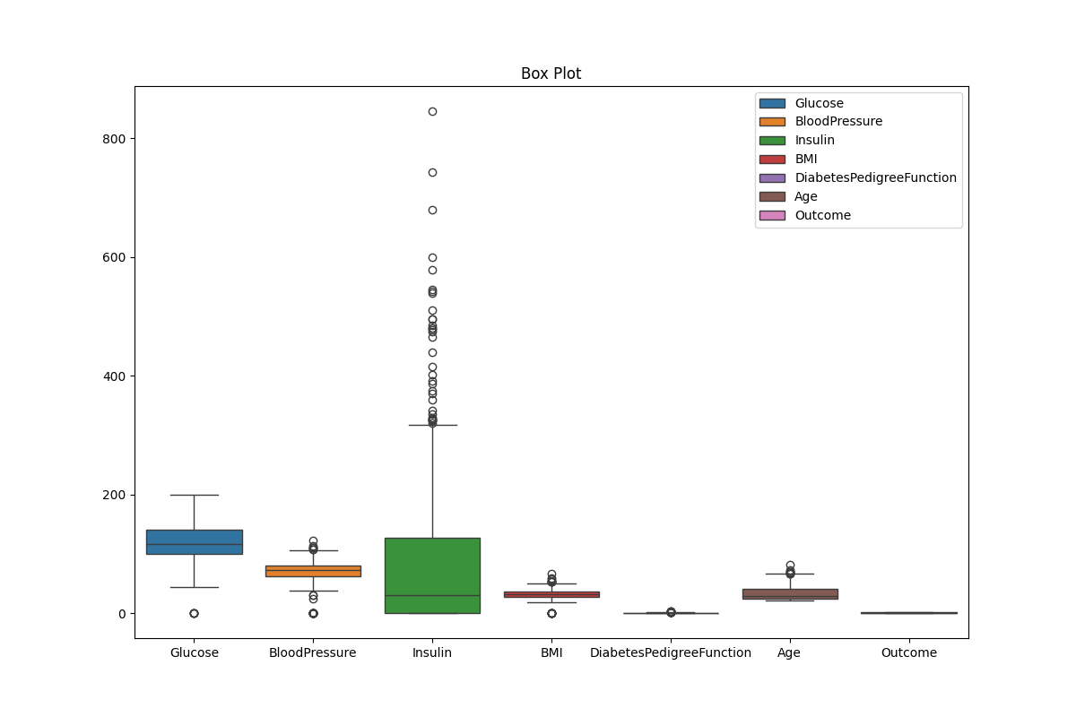
Plots:
1.BoxPlot To Visualize Outliers

Slide 6
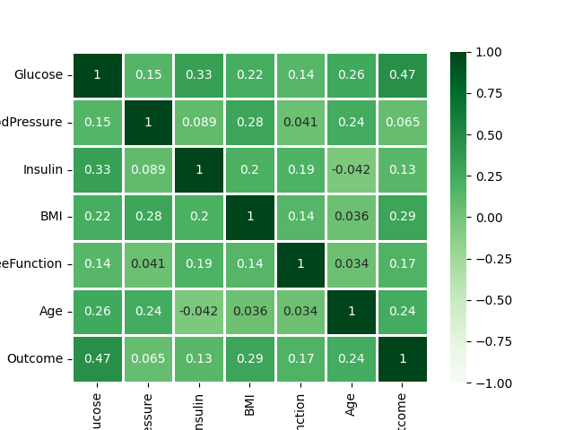
Plots:
2.Heatmap To Visualize Correlation Between Columns

Slide 7
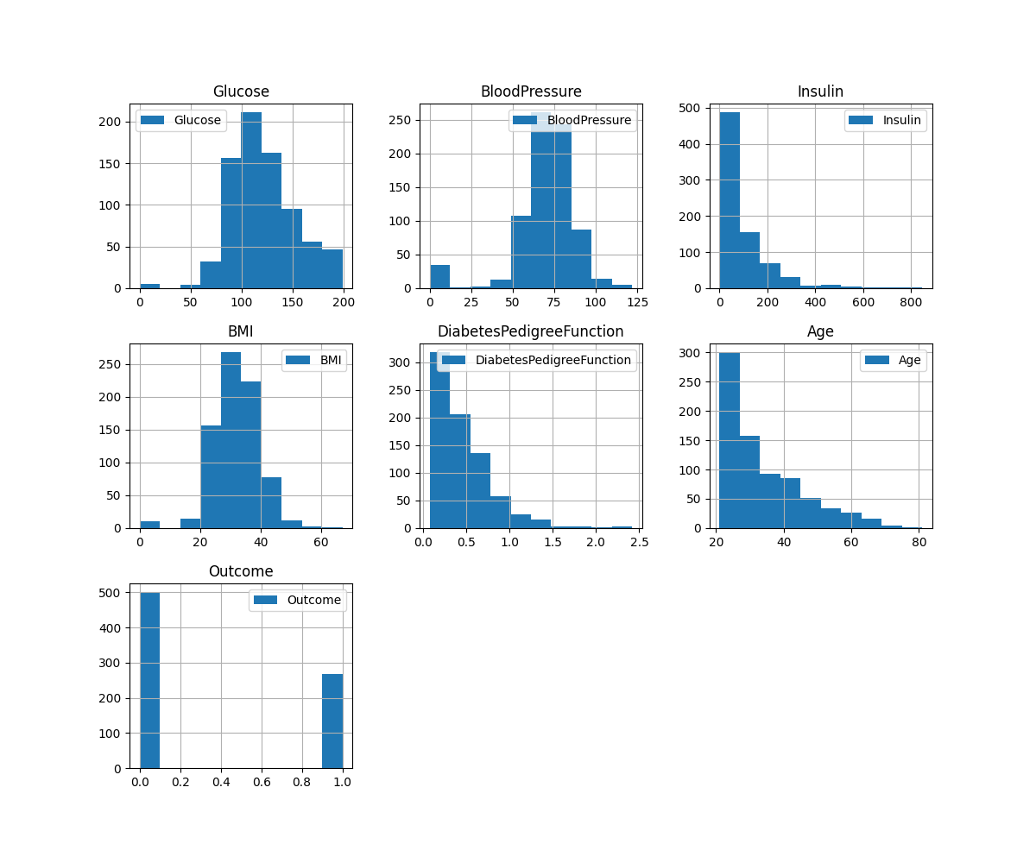
Plots:
3. HistPlot To Visualize Frequency - i

Slide 8
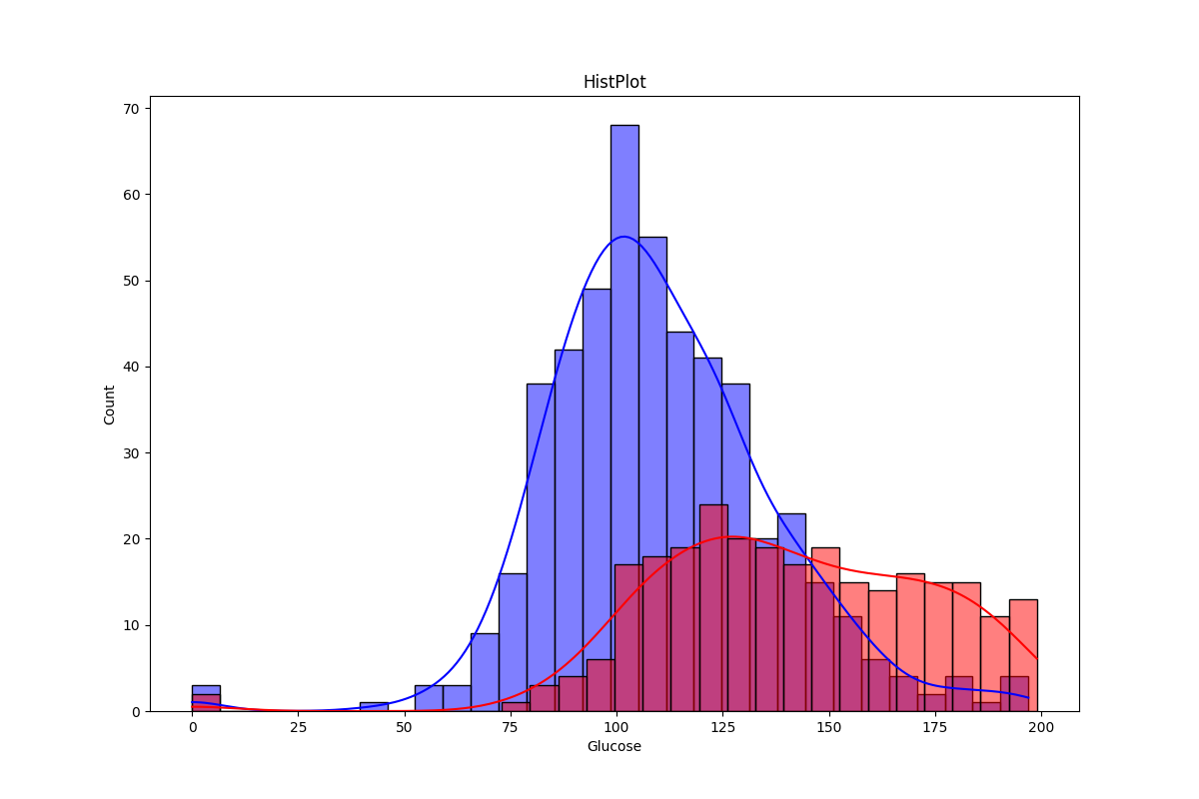
Plots:
3. HistPlot To Visualize Frequency - ii

Slide 9
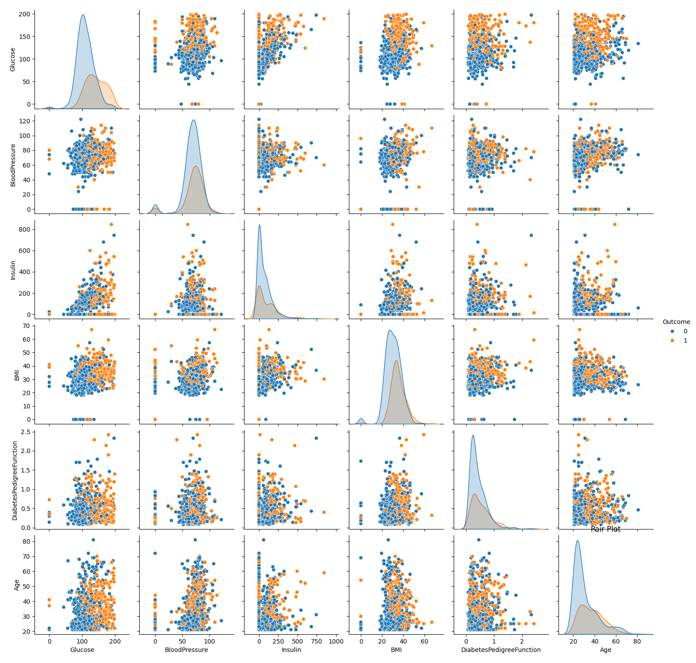
Plots:
4.PairPlot To Visualize Relationship Between All Columns

Slide 10
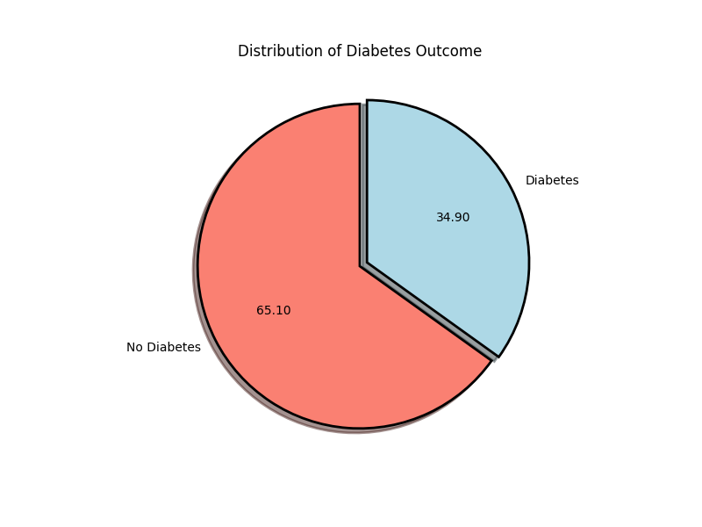
Plots:
5. PiePlot To Visualize Target Column

Slide 11
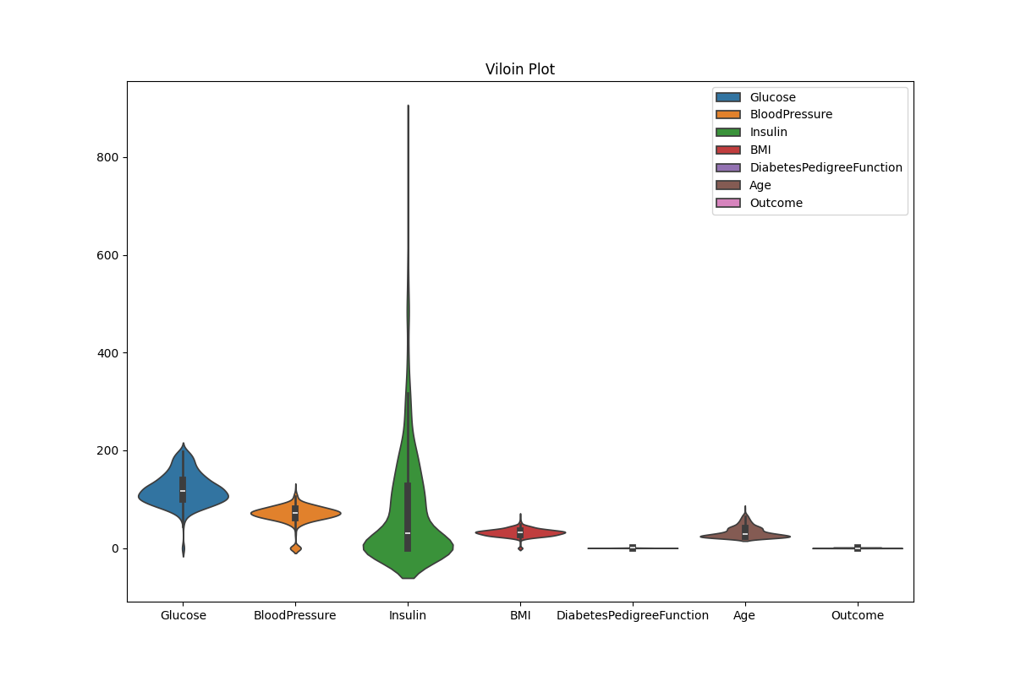
Plots:
6. ViolinPlot To Visualize Distribution Of Numeric Data

Slide 12
Model Training
Models Used:
Logistic Regression
Random Forest Classifier
Decision Tree Classifier
K Nearest Neighbors
Support Vector Classifier
Training Process:
Fit each model on the training data.

Slide 13
Model Evaluation Metrics
Metrics:
Accuracy
Precision
Recall
F1 Score
ROC AUC

Slide 14
Metrics:
 | Accuracy | Precision | ReCall | F1 Score | ROC AUC
Logistic Regression | 0.7597 | 0.6731 | 0.6364 | 0.6542 | 0.7323
Random Forest | 0.7727 | 0.6724 | 0.7091 | 0.6903 | 0.7586
Decision Tree | 0.7403 | 0.619 | 0.7091 | 0.661 | 0.7333
K Nearest Neighbors | 0.7532 | 0.6545 | 0.6545 | 0.6545 | 0.7313
Support Vector Classifier | 0.7468 | 0.66 | 0.6 | 0.6286 | 0.7141

Slide 15
User Input and Predictions
User Input Features:
List of input features: Glucose, Blood Pressure, Insulin, BMI, Diabetes Pedigree Function, Age.
Prediction Results:
Display how the application predicts diabetes based on user input for each model.

Slide 16
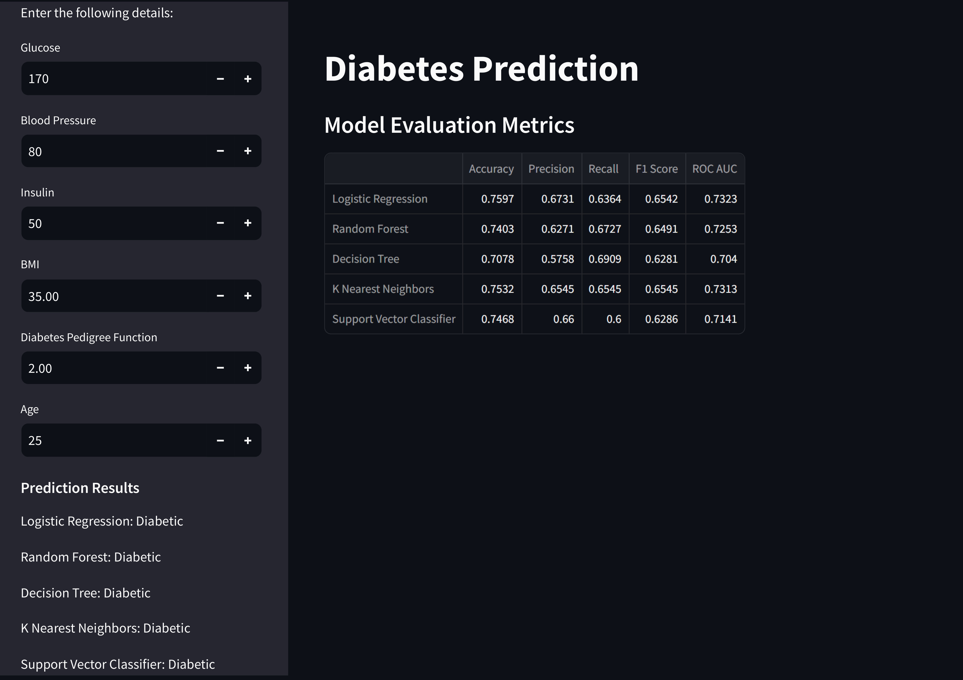
Application Demo

Slide 17
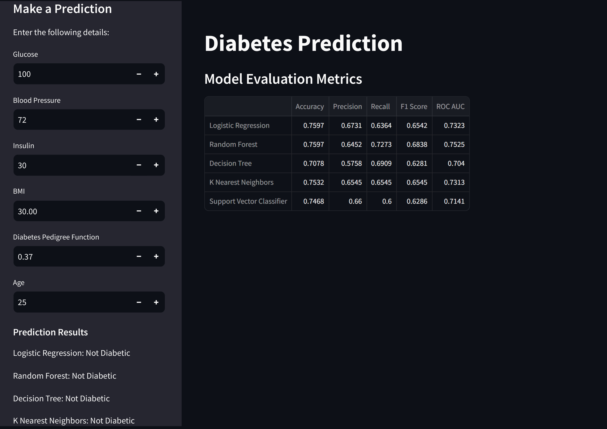
Application Demo

Slide 18
Conclusion
The objective of this project was to predict the likelihood of diabetes in patients using various machine learning classifiers.
We used the Pima Indians Diabetes Dataset and performed data preprocessing steps including feature scaling and
imputation of missing values.
Five different models were trained: Logistic Regression, Random Forest Classifier, Decision Tree Classifier, K Nearest Neighbors, and Support Vector Classifier.
Each model was evaluated using metrics such as accuracy, precision, recall, F1 score, and ROC AUC score.

